Slide 1
Seoul Average Weekday Bike Rentals per Hour
File created on: 2/23/2026 9:12:31 AM

Slide 2
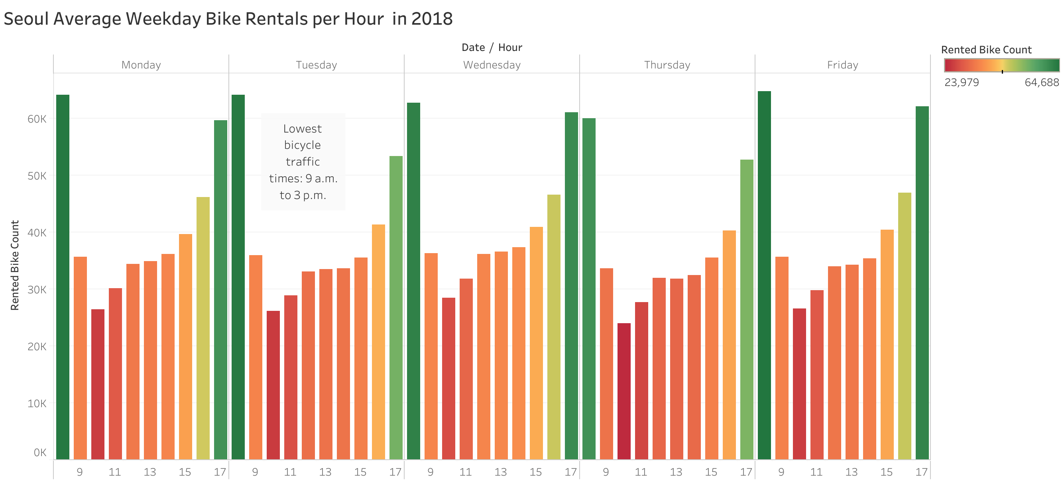

Slide 3
